Slide 1


Empathy
The Intersection Café
Collaborate | Coordinate | Co-create

Slide 2
The Intersection Café - Forum for Group Work
The Intersection café is the place where the team gets together to discuss, brainstorm, and collaborate on their Projects.
It is a space where all diversity is welcome for sharing of questions, thoughts that converge to ideas in a creative and constructive manner. It is a movement of divergence to convergence
The team uploads and presents each module assignment to mentor for review and further refinements
Intersection Cafe: Collaborate | Coordinate | Co-create

Slide 3
The Intersection Café - Forum for Group Work
Guidance for Group Work
Appoint or agree on a spokesperson or coordinator (can be by turns)
Call out individual persons to contribute to each of the topics
Insert text boxes and content with name and date turn by turn until the topic is complete, example:
If content/ idea in comment boxes is not clear the coordinator can clarify
Once the topic is complete, the coordinator assimilates the content
If any comment needs to be addressed to a groupmate use the comment box and tag the team member using @ followed by their email id to send an email update, example: @ketan309@gmail.com
Name: Ketan Date: 25th Nov 2020
IDEA: XXXXXX
Name: Aishwarya Date: 26th Nov 2020
IDEA: YYYYYYYY
Intersection Cafe: Collaborate | Coordinate | Co-create

Slide 4
The Empathy Module Outcomes
The outcome from the Empathy Module will be :
A self exploration that will help to sensitize one towards empathy
Understanding and awareness of how to conduct a preliminary survey on your project by meeting with stakeholders to get initial perspectives and set the context for a deeper study
Create a detailed questionnaire for interviews and observations to create an Empathy Map that will open the opportunities and issues that need to be innovatively worked with
At the same time observe, interview and fill in the Empathy Statement, with a structured approach
Intersection Cafe: Collaborate | Coordinate | Co-create

Slide 5
EXERCISE 1 - Questionnaire : The Don'ts
DO NOT:
Look at the questionnaire as you ask the questions. This might make the target group insecure.
Interrupt when they are talking.
Use technical terms they might not understand. Speak in regional language if possible.
Ask them to stop talking or pause as you take notes. Take a recording if possible.
Take videos without permission.
Leak personal information amongst the members of the target group.
Discuss or summarise in front of the target group.
Make the target group uncomfortable in any way.
Promise to solve their problem, yet.
Intersection Cafe: Collaborate | Coordinate | Co-create

Slide 6

Sample Questionnaire
This next section will act as a guide in helping you choose from and understand better through cue questions and answers to come up with your own questionnaire (after group discussion) based on the chosen target group.
Intersection Cafe: Collaborate | Coordinate | Co-create

Slide 7
Interview Preamble.
The target group identiﬁed is (Number of People, Location, Community, Average age group, Educational background,Financial status, Position in the society)...
Eg -
We are 3rd Year students from ABC Tech and, as a part of our curriculum, we need to take up a project to ﬁnd out and understand Stakeholder needs, business challenges and how we can get insights, work on human centric solution that can be beneﬁcial to the target group/Stakeholders.
Pre-work - Initial Visit to set the context and get to meet the stakeholders and create a list.
Then detail the roles on who will be the users or beneﬁciaries, the resource/service providers-(like money or facilities) people who need to give permission and people who need to support.
Revisit the stakeholders for a detailed interviews as per the Questionnaire and Empathy Statement.
Intersection Cafe: Collaborate | Coordinate | Co-create

Slide 8

COMMUNITY - Definition
Definition
Community is a social unit (a group of living beings) with commonality such as norms, age, values, language, customs, or identity.
Communities may share a sense of place situated in a given geographical area (e.g. a country, village, town, or neighbourhood) or in virtual space through communication platforms.
Intersection Cafe: Collaborate | Coordinate | Co-create

Slide 9
Stakeholder Definition
Stakeholders are set of people and/or organizations who will participate on the stated Project (mention)
Users or Beneficiaries - sometimes there can be two beneficiaries, as primary and secondary stakeholders - example: farmers and customers or traders, public and government
Permission Givers - like local authorities, panchayats, Business,
Sponsors- provide money/materials and capital and advance buying of the product,
Implementers- Who will implement the agreed solution and maintain?
Sustenance - Who will maintain and ensure continuous usage or as and when required ?
Intersection Cafe: Collaborate | Coordinate | Co-create

Slide 10
Project
Project can be specific problems or opportunities, which will be beneficial to the actual users, related customers, traders community and society. These can be both stated and unstated that the individuals and community are experiencing.
The Project could be an age old opportunity never resolved or a new opportunity that has come up with changes in situation such as technology and growth.
Intersection Cafe: Collaborate | Coordinate | Co-create

Slide 11
Sample Interview Questionnaire
A sample set of questions for getting in depth information is presented in the next few slides
About 16 illustrative questions have been prepared for your study, please study them based on your project and prepare your own set of cue questions for the interviews.
Note - Remember, these are only sample questions for reference, please come up with your own ideas.
Intersection Cafe: Collaborate | Coordinate | Co-create

Slide 12
Project Title-Stakeholder Basic Details- Primary (1)
Title: |  | Community : | Team members :
Name : | Contact Number : | Gender : | Education: | Other details
Family Details : | Friends: | Skills: | Technology awareness & uses:
1. May I ask you to share the nature of the issues or challenges that you are facing ?
Say..
2. Who do you think is being aﬀected the most by the difficulties in Jaggery Production ?
Think
3. How do you think they are being aﬀected by the difficulties ? What are the pains and frustrations?
Think & Pains
4. What do you think is the cause of the production challenge ?
Think & cause
Intersection Cafe: Collaborate | Coordinate | Co-create

Slide 13
Project-Stakeholder Basic Details- Primary (2)
Project Title |  | Team members
5. What do you feel about this challenge ? (emotions)
feel ..
6.Are they others who feel strongly about this Project and if so in what way? What do they say?
feel & hear
7. Have you or any others taken some action to solve this challenge ? If yes, what were the actions and the outcome?
do
7.1 If not, why do you think no actions have been taken?
think & do
8.0 What do you think is the cause of the problem? Can you initiate some actions?
think & do
Intersection Cafe: Collaborate | Coordinate | Co-create

Slide 14
Project-Stakeholder Basic Details- Primary (3)
Project Title |  | Team members:
9. Who has the power or authority to bring about change?
say or hear.
10. Who do you think among the users will be quick to change? & Who among the users may be slow to change?
think
11. Who will be naysayers and then eventually follow when there is no choice? Who could be disruptors?
think
12. Have you heard anyone talking about the Project and what have you heard?
hear
13. Who all will gain or benefit by solving the Project? Please share your gains for yourself and others
Intersection Cafe: Collaborate | Coordinate | Co-create

Slide 15
Project-Stakeholder Basic Details- Primary (4)
Project Title |  | Team members
14. You may be knowing many people who are facing this Project ? Can you share their views if you have discussed?
hear
15. Does this social Project happens only sometimes or it always present ?
hear
16. Any other points or thoughts that you would like to share ?
Intersection Cafe: Collaborate | Coordinate | Co-create

Slide 16

Cue Questions for Stakeholders- Primary
Use this space to enter your own cue questions, based on your Project using the the exemplar statements in the previous slides
Name of Team Member:
Question(s):
Name of Team Member:
Questions(s):
Name of Team Member:
Question(s):
Name of Team Member:
Questions(s):
Hint: Please distribute your questions to cover aspects of Say, Do, Think and Feel
Name of Team Member:
Question(s):
Name of Team Member
Questions(s):
Intersection Cafe: Collaborate | Coordinate | Co-create

Slide 17
Cue Questions for Stakeholders- Primary
Use this space to enter your own cue questions, based on your Project using the the exemplar statements in the previous slides
Name of Team Member:
Question(s):
Name of Team Member:
Questions(s):
Name of Team Member:
Question(s):
Name of Team Member:
Questions(s):
Hint: Please distribute your questions to cover aspects of Say, Do, Think and Feel
Name of Team Member:
Question(s):
Name of Team Member
Questions(s):
Intersection Cafe: Collaborate | Coordinate | Co-create

Slide 18
Cue Questions for Stakeholders- Primary
Use this space to enter your own cue questions, based on your Project using the the exemplar statements in the previous slides
Name of Team Member:
Question(s):
Name of Team Member:
Questions(s):
Name of Team Member:
Question(s):
Name of Team Member:
Questions(s):
Hint: Please distribute your questions to cover aspects of Say, Do, Think and Feel
Name of Team Member:
Question(s):
Name of Team Member
Questions(s):
Intersection Cafe: Collaborate | Coordinate | Co-create

Slide 19
Project-Stakeholder Basic Details- Secondary (1)
Project Title: |  | Community : | Team members
Name : | Contact Number : | Gender : | Education: | Hobbies:
Family Details : | Brother/Sisters | Skills: | Technology awareness & uses
1. May I ask you to share the nature of the Projects that you are facing now directly or indirectly ?
Say..
2. Who do you think is being aﬀected the most in this Project?
Think
3. How do you think they are being aﬀected by this challenge ? What are the pains and frustrations?
Think & Pains
4. What do you think is the cause of the Project ?
Think & cause
Intersection Cafe: Collaborate | Coordinate | Co-create

Slide 20
Project-Stakeholder Basic Details- Secondary (2)
Project Title |  | Team members
5. What do you feel about this Project ? (emotions)
feel ..
6.Are they others who feel strongly about this Project and if so in what way? What do they say?
feel
7. Have you or any others taken some action to solve this challenge ? If yes, what were the actions and the outcome?
do
7.1 If not, why do you think no actions have been taken?
think & do
8.0 What do you think is the cause of the problem? Can you initiate some actions?
think & do
Intersection Cafe: Collaborate | Coordinate | Co-create

Slide 21
Project-Stakeholder Basic Details- Secondary (3)
Project Title |  | Team members
9. Who has the power or authority to bring about change?
say or hear.
10. Who do you think will be quick to change? & Who will be slow to change?
think
11. Who will be naysayers and then eventually follow when there is no choice? Who will be disruptors?
think
12. Have you heard anyone talking about the Project and what have you heard?
hear
13. Who all will gain or benefit by solving the Project? Please share your gains for yourself and others
Intersection Cafe: Collaborate | Coordinate | Co-create

Slide 22
Project-Stakeholder Basic Details- Secondary (4)
Project Title |  | Team members
14. You must be knowing many people who are facing this Project ? Can you share their views if you have discussed?
hear
15. Does this social Project happens only sometimes or it always present ?
hear
16. Any other points or thoughts that you would like to share ?
Intersection Cafe: Collaborate | Coordinate | Co-create

Slide 23
Cue Questions for Stakeholders- Secondary
Use this space to enter your own cue questions, based on your Project using the the exemplar statements in the previous slides
Name of Team Member:
Question(s):
Name of Team Member:
Questions(s):
Name of Team Member:
Question(s):
Name of Team Member:
Questions(s):
Hint: Please distribute your questions to cover aspects of Say, Do, Think and Feel
Name of Team Member:
Question(s):
Name of Team Member
Questions(s):
Intersection Cafe: Collaborate | Coordinate | Co-create

Slide 24
Cue Questions for Stakeholders- Secondary
Use this space to enter your own cue questions, based on your Project using the the exemplar statements in the previous slides
Name of Team Member:
Question(s):
Name of Team Member:
Questions(s):
Name of Team Member:
Question(s):
Name of Team Member:
Questions(s):
Hint: Please distribute your questions to cover aspects of Say, Do, Think and Feel
Name of Team Member:
Question(s):
Name of Team Member
Questions(s):
Intersection Cafe: Collaborate | Coordinate | Co-create

Slide 25
Cue Questions for Stakeholders- Secondary
Use this space to enter your own cue questions, based on your Project using the the exemplar statements in the previous slides
Name of Team Member:
Question(s):
Name of Team Member:
Questions(s):
Name of Team Member:
Question(s):
Name of Team Member:
Questions(s):
Hint: Please distribute your questions to cover aspects of Say, Do, Think and Feel
Name of Team Member:
Question(s):
Name of Team Member
Questions(s):
Intersection Cafe: Collaborate | Coordinate | Co-create

Slide 26
Project-Stakeholder Details-Sponsors
Project (sc) Title : |  | Community : | Team Members :
Please mention the nature of stakeholder | 1 | 2 | 3 | 4
Name
Contact Number
Details of how they can contribute
What do the sponsors:
Say about the sc
Think about the sc
What do they feel about the sc
What are they ready to do ?
Intersection Cafe: Collaborate | Coordinate | Co-create

Slide 27
RESOURCES- Definitions
Resources: Something that is ready for use or drawn upon for use in the proposed solution, they are attributes that are present in the system and surroundings.
Some of Resource you may consider and obtain details are about :
Sponsors- Industries, Government, Parents, Retailers, Institutions, Foundations.
Implementers - Teachers, Volunteers, NGO’s, Parents, Friends.
Utility - Electricity, Water , Air
Natural resources - like solar, wind, wood
Gadgets - Internet, computers, tabs and smartphones
Space - open/covered
Transportation- private & public
Money, Materials, Useable Waste Materials
Any other
Intersection Cafe: Collaborate | Coordinate | Co-create

Slide 28
RESOURCES – List of resources available
Resources | List the Details
Sponsors-
Implementers -
Utility -
Natural resources -
Gadgets -
Space -
Transportation-
Money, Materials & Useable Waste Materials
Any Others
Intersection Cafe: Collaborate | Coordinate | Co-create

Slide 29

Exercise 2:
The Empathy Map
Intersection Cafe: Collaborate | Coordinate | Co-create

Slide 30

Watch this video to understand
how to create the Empathy Map
https://youtu.be/akmkbYlgAA4
Intersection Cafe: Collaborate | Coordinate | Co-create

Slide 31
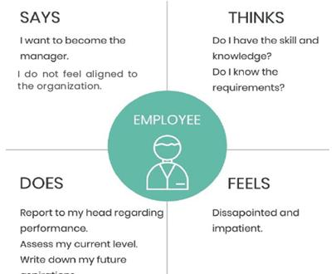
An Example of
Empathy Map
⬅️
Based on the Questionnaire information and the the example prepare your Empathy Map as per next slide format- you may change the image appropriate to your project
Pain Points | Gains
Intersection Cafe: Collaborate | Coordinate | Co-create

Slide 32

Your Project Empathy Map
say | do
think | feel
pain points | gains
Intersection Cafe: Collaborate | Coordinate | Co-create

Slide 33
Exercise 3 :
The Empathy Statement
Intersection Cafe: Collaborate | Coordinate | Co-create

Slide 34
Empathy Statement for Your Project
Empathy Statement is a structured approach to interview and gather information that is required to get multiple perspectives about the Project in order to define in depth the nature of Projects, the system details, the causes, the inputs, situation aspects, how long the situation exists and a possible ideal solution.
Intersection Cafe: Collaborate | Coordinate | Co-create

Slide 35
Empathy Statement for Project
Details of the Target Group- The Project
Actual users:
Permission Givers:
Service Providers:
Decision Makers :
Intersection Cafe: Collaborate | Coordinate | Co-create

Slide 36
1.0 The Project stated or faced by the target group (1)
Describe your Project in a single, simple phrase. use “everyday” language such as that you would use to speak to your friend or siblings - For example: In the night time it is difficult to walk in the streets as it is very dark or relevant software and hardware is not available to learn latest computer technology
Enter
Intersection Cafe: Collaborate | Coordinate | Co-create

Slide 37
2.0 Information about the System, Community and Surroundings (1)
2.1 System Name- Describe the system from which your Project is considered ?
System Name can be: Education, Health, Farming ,Agriculture, Literacy, Hygiene, Waste Management, Drinking water, Pollution, Drainage, Lighting, Addictive Habits, Bus station, Railways Station, Parks
Enter
Describe the community area where the system is located (farming, trading, industry, market place, school, college, residential locality, hospital, railway station, bus stand , parks, etc.)
Enter
Intersection Cafe: Collaborate | Coordinate | Co-create

Slide 38
2.0 Information about the System, Community and Surroundings (2)
2.2 System Details-
Nature of service and its elements- for say computer literacy Who provides the service : School teacher Who receives the service (the outcome) : 8th standard students What inputs or materials are used: Notebooks for taking class notes and exercises How much area is used: 5 feet by 5 feet for workstation and for 20 students about 500 square feet What is infrastructure like furniture or software or hardware- computer, workstation, keyboard, mouse and power, chairs Add more simple elements- like lights, fans
So, list out for your Project in a similar way
Intersection Cafe: Collaborate | Coordinate | Co-create

Slide 39
2.0 Information about the System, Community and Surroundings (3)
2.3 Functioning of the Current System or Absence of any system
Useful is what is beneficial and gainful to the user and community and harmful is what is causes pain/difficulty to user. Example :Computer literacy – there are systems available, curriculum well defined and workstations available that is beneficial, the harmful aspect is outdated systems, that do not work well, are ,slow, no proper virus protection
Enter
Intersection Cafe: Collaborate | Coordinate | Co-create

Slide 40
2.0 Information about the System, Community and Surroundings (4)
2.4 Environment of the community or the area of study
Describe the environment around the place of study - Roads, shops, market, place of worship, trees, water body etc. For Computer Literacy: Environment is School Classroom /Computer lab, Air Conditioned or Ambient temperature,
Enter
Intersection Cafe: Collaborate | Coordinate | Co-create

Slide 41
3.0 Information about the Project (1)
3.1 The opportunity that the Project presents when resolved that will be beneficial to users
Describe the nature of the Project : Not enough computer literacy , students are not offered relevant computer classes or there is no proper facility or curriculum is old
Enter
3.2 Describe reasons that could be causing the problems. List various direct and related reasons Example : high class strength, teacher availability, no proper facilities
Enter
Intersection Cafe: Collaborate | Coordinate | Co-create

Slide 42
3.0 Information about the problem situation or opportunity stated (2)
3.3 What might happen if the Project continues to exist in the same manner?
Like low computer literacy would mean not able to cope with current trends, study well for exams through internet, self education ..
Enter
3.4 What might be the other problems / resistance that might surface while attempting to solve this Project ? Parents may be reluctant as it may lead to distractions, students may surf for games, movies and get addicted, may become over reliant on self study versus class room study
Enter
Intersection Cafe: Collaborate | Coordinate | Co-create

Slide 43
4.0 Ideal Vision of the Solution (1)
What do you think is an ideal solution? Describe the ideal solution to actual beneficiaries or users and all others who benefit by the solution. Everything in the system changes or remains unchanged or becomes less complicated, while <describe a required function> appears, or <describe a harmful function> disappears.
Computer Literacy : An ideal vision, is all students in 8th standard must have computer education in a way that will benefit their understanding of the subject, provoke interest in computer sciences both as a subject and as a means for to learn other subjects through the internet through trusted and available search sites.
Enter
Intersection Cafe: Collaborate | Coordinate | Co-create

Slide 44
5.0 What are the available resources that are favourable in solving the problem? (1)
Describe the resources available in the surroundings, like buildings, educated people, previous beneficiaries, case studies, furniture, natural resources, sponsors.
There is a computer lab available though not updated with current software and hardware, teachers are available who can upgrade their knowledge so that they can teach, in some of the other schools, some industries have sponsored hardware and software provided they are used well.
Enter
Intersection Cafe: Collaborate | Coordinate | Co-create

Slide 45
6.0 What can be changed and not changed about the Project ? (1)
Describe the allowable changes to the system. Upgradation is possible and within the available space. The space can be well ventilated and may required air conditioning
Enter
What are your limitations in solving this particular Project ? May not be able to afford new systems and need to have an IT expertise to maintain and upgrade the current system. This expertise is not easily available as of now.
Enter
Intersection Cafe: Collaborate | Coordinate | Co-create

Slide 46
7.0 What will be the criteria for selecting solution concepts? (1)
Describe the success criteria, like easy to adopt- all stakeholder have agreed and have no difficulties ( students, like to learn, teachers know to teach and parents benefit with the new education) can be implemented with available resources or low costs– by getting sponsors & possible community funding can be done in quick time- does not need too much time, the required resources are available quality is appealing,- well thought about and properly designed can be sustained, - by ensuring gains are very beneficial here is gain all around- see point 1
Enter
Intersection Cafe: Collaborate | Coordinate | Co-create

Slide 47
8.0 Project data
Project timeline: (MM/DD/YY to MM/DD/YY)
Project team contact information (Name, E-mail, Phone)
Intersection Cafe: Collaborate | Coordinate | Co-create

Slide 48
Great Work Team!

Slide 49
Define
The Intersection Café
Collaborate | Coordinate | Co-create

Slide 50

The Define Module
The outcome of Define Module:
To learning how to Create the Stakeholder Personas from Empathy Map.
Based on the Empathy Statement and Stakeholder Personas Reframe the Project Statement with a Point Of View Statement
Note : Once you start working on defining your project and observe that collected data is not sufficient to work with, then please go back to respective stakeholders or community and collect the necessary information. Remember Design Thinking is an iterative process.
Intersection Cafe: Collaborate | Coordinate | Co-create

Slide 51

Stakeholder Persona-Lesson 2
As a part of field work and studies, you have collected information on Stakeholders and the next step is to create the Stakeholder Persona.
You have also gone through the case studies and lessons on what is Stakeholder Persona and how to create.
Please go through the Empathy Questionnaire and from your notes, create a Stakeholder Persona as per the format in next slide and you are free to change the image in the frame.
Do create a separate Stakeholder Persona for each Primary and Secondary Stakeholder and then Final Consolidated Persona(s)
This activity should be done by the group and everyone must contribute.
Intersection Cafe: Collaborate | Coordinate | Co-create

Slide 52
Stakeholder Persona-Lesson 2
Primary
Intersection Cafe: Collaborate | Coordinate | Co-create

Slide 53

Teammate’s Name -
Stakeholder Persona-1
Write a brief description
Demographics Age: Gender: Family:
Goal/ Needs ❑. ❑.
Pain Points ( from Empathy map & statement) ❑. ❑. ❑. ❑.
Traits ❑. ❑. ❑.
Skills ❑. ❑.
Name -
Intersection Cafe: Collaborate | Coordinate | Co-create

Slide 54

Teammate’s Name -
Stakeholder Persona-2
Write a brief description
Demographics Age: Gender: Family:
Goal/ Needs ❑. ❑.
Pain Points ( from Empathy map & statement) ❑. ❑. ❑. ❑. ❑.
Traits ❑. ❑. ❑.
Skills ❑. ❑.
Name -
Intersection Cafe: Collaborate | Coordinate | Co-create

Slide 55

Teammate’s Name -
Stakeholder Persona-3
Write a brief description
Demographics Age: Gender: Family:
Goal/ Needs ❑. ❑.
Pain Points ( from Empathy map & statement) ❑. ❑. ❑. ❑. ❑.
Traits ❑. ❑. ❑.
Skills ❑. ❑.
Name -
Intersection Cafe: Collaborate | Coordinate | Co-create

Slide 56

Teammate’s Name -
Stakeholder Persona-4
Write a brief description
Demographics Age: Gender: Family:
Goal/ Needs ❑. ❑.
Pain Points ( from Empathy map & statement) ❑. ❑. ❑. ❑. ❑.
Traits ❑. ❑. ❑.
Skills ❑. ❑.
Name -
Intersection Cafe: Collaborate | Coordinate | Co-create

Slide 57
Stakeholder Persona
Secondary
Intersection Cafe: Collaborate | Coordinate | Co-create

Slide 58

Teammate’s Name -
Stakeholder Persona-5
Write a brief description
Demographics Age: Gender: Family:
Goal/ Needs ❑. ❑.
Pain Points ( from Empathy map & statement) ❑. ❑. ❑. ❑. ❑.
Traits ❑. ❑. ❑.
Skills ❑. ❑.
Name -
Intersection Cafe: Collaborate | Coordinate | Co-create

Slide 59

Teammate’s Name -
Stakeholder Persona-6
Demographics Age: Gender: Family:
Goal/ Needs ❑. ❑.
Pain Points ( from Empathy map & statement) ❑. ❑. ❑. ❑. ❑.
Traits ❑. ❑. ❑.
Skills ❑. ❑.
Name -
Intersection Cafe: Collaborate | Coordinate | Co-create

Slide 60

Teammate’s Name -
Stakeholder Persona- 7
Write a brief description
Demographics Age: Gender: Family:
Goal/ Needs ❑. ❑.
Pain Points ( from Empathy map & statement) ❑. ❑. ❑. ❑. ❑.
Traits ❑. ❑. ❑.
Skills ❑. ❑.
Name -
Intersection Cafe: Collaborate | Coordinate | Co-create

Slide 61

Final Consolidated Persona- Primary
Write a brief description
Demographics Age: Gender: Family:
Goal/ Needs ❑. ❑.
Pain Points ( from Empathy map & statement) ❑. ❑. ❑. ❑. ❑.
Traits ❑. ❑. ❑.
Skills ❑. ❑.
Name -
Intersection Cafe: Collaborate | Coordinate | Co-create

Slide 62
Final Consolidated Persona-Secondary
Write a brief description
Demographics Age: Gender: Family:
Goal/ Needs ❑. ❑.
Pain Points ( from Empathy map & statement) ❑. ❑. ❑. ❑. ❑.
Traits ❑. ❑. ❑.
Skills ❑. ❑.
Name -
Intersection Cafe: Collaborate | Coordinate | Co-create

Slide 63
Point Of View Checklist-Lesson 4
(Click on the link and share your details) Point of view (POV) checklist should help you to
1. Provide focus and frame the problem statement
2. Inspire the team with a challenging statement
3. Provide a reference for evaluating competing ideas-in terms of the need well articulated
4. Empower team members to make decisions in response to the high-level goals of the team
5. Fuel brainstorms by suggesting “how might we”statements
6. Capture the hearts and minds of people you meet —the users and stakeholders
7. Save you from the difficult task of developing solution concepts that are all things to all people you cannot satisfy everyone
8. Allow you to revisit and reformulate the POV as you learn by doing
9. Guide your solution and innovation efforts So based on the above guidelines prepare your POV statements both in selfnotes and then together work in the Intersection café for your Project
Intersection Cafe: Collaborate | Coordinate | Co-create

Slide 64
Point of View Statement-Lesson 4
Now you are familiar in creating Point of View Statement by reframing the Initial statement through the Stakeholder Persona and using the 3 elements of POV
The next step is to convert your initial Project statement into a POV statement in an evolved way.
Please see the format in next slide and create.
Intersection Cafe: Collaborate | Coordinate | Co-create

Slide 65
Using the approach of User, Needs and Insight reframe the the Project Statement- each team creates one and then consolidates
User:
Need:
Insights:
User:
Need:
Insights:
User:
Need:
Insights:
User:
Need:
Insights:
User:
Need:
Insights:
User:
Need:
Insights:
User:
Need:
Insights:
Intersection Cafe: Collaborate | Coordinate | Co-create

Slide 66
Reframed Project Statement (consolidated)
Who are the users?
What is the need for the user?
What are our insights ?
Consolidated POV Statement :
Intersection Cafe: Collaborate | Coordinate | Co-create

Slide 67
Great Work Team!

Slide 68
Ideate
The Intersection Café
Collaborate | Coordinate | Co-create

Slide 69

The Ideate Module
The Outcome of Ideate Module:
System Approach :
We begin the preliminary analysis of a problem situation or the Project by applying one of the basic premises of I-TRIZ, or Theory of Inventive Problem Solving through a Systems Approach.
For wicked or complex Projects it is difficult to address all these details at once. The system approach helps by providing a systematic method of analysing a problem situation from different perspectives.
Note : Once you start working on Ideate phase for your project and observe that collected data is not sufficient to work with, then please go back to respective stakeholders or community and collect the necessary information. Remember Design Thinking is an iterative process.
Intersection Cafe: Collaborate | Coordinate | Co-create

Slide 70
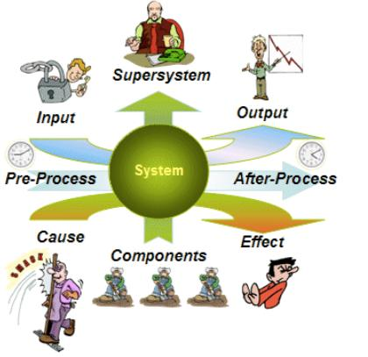
The Ideate Module-The Systems Perspective
Most people try to solve a problem by focusing on the system in which it occurs. But experienced innovators think differently, viewing the problem or Project simultaneously from multidimensional creative thinking consisting of the following dimensions:
The system, its subsystems, and related supersystems.
The past and possible future of the system, subsystems and super-systems.
The cause of the problem, the undesired effects that result, and the related system functions.
The system's inputs and outputs and their relationships to the problem.
Formulate your Ideal Visions by answering the Question:
What should be changed to resolve the Project?
Intersection Cafe: Collaborate | Coordinate | Co-create

Slide 71
The Ideate Module
” It is better to answer one question eight different ways than eight different questions in one way”
Plato
Intersection Cafe: Collaborate | Coordinate | Co-create

Slide 72
The Ideate Module-Some Guidelines
Form an Ideal Vision of the solution to your Project using these guidelines: (refer to Empathy statement
Imagine that you have a magician at your disposal who can do anything you ask. What would you have him do to solve the problem?
Envision the ideal solution by formulating the "mini-Project or problem " -- the problem that, when solved, will resolve the original situation with minimal changes to the system. Use this template as a guide:
Everything in the system remains the same or becomes less complicated, yet the desired result appears or the harmful effect disappears.
For now, avoid thinking about how the ideal vision might be realized -- that step will come later.
Intersection Cafe: Collaborate | Coordinate | Co-create

Slide 73

System Perspective for your Project
By understanding the examples shared in the LMS about Taking Students Back to School.
Compare your responses with the team for a shared understanding
For your Project create a systems perspective as per the forms shared in the next set of slides .
Intersection Cafe: Collaborate | Coordinate | Co-create

Slide 74
System Perspective for your Project.1
Controls
Create your IDEFO Chart- you can draw in A4 paper or in an excel sheet –refer example in LMS
A process sequence representation
Inputs
Process activity-1
Outputs
Process activity-2
Resources
Any additional Inputs
Process activity-3
Any additional Inputs
Intersection Cafe: Collaborate | Coordinate | Co-create

Slide 75
System Perspective for your Project.2
Cause and Effect |  |  |  | (the 6 parameters)
 | Undesired Effect | Cause | Why | Attribute
1
2
3
4
5
6
 | As you complete this exercise, you may start getting ideas to solve the causes for the Undesired effect, start listing these down in the next slide
Refer to the six factors in your lesson to decide the cause attribute
Intersection Cafe: Collaborate | Coordinate | Co-create

Slide 76
System Perspective for your Project.2
Idea listing for elimination of causes that create Undesired Effect
 | Undesired Effect | Cause | Why | Ideas
1
2
3
4
5
6
Intersection Cafe: Collaborate | Coordinate | Co-create

Slide 77
System Perspective for your Project.3
Input –Process -Output
 | Input | Process | Output
1
2
3
4
5
6
 | As you complete this exercise, you may start getting ideas to improve the inputs that may not be right or proper or incorrect
Intersection Cafe: Collaborate | Coordinate | Co-create

Slide 78
System Perspective for your Project.3
Input –Process –Output 🡪 Idea listing to Improve the input quality &/or process
 | Input | Process | ideas to improve | Output
1
2
3
4
5
6
Intersection Cafe: Collaborate | Coordinate | Co-create

Slide 79
System Perspective for your Project.4
9 Box Grid – Systems of Systems
Super Systems
System
Sub Systems
Note: The future may give some ideas for the present | Past | Present | Future
Intersection Cafe: Collaborate | Coordinate | Co-create

Slide 80
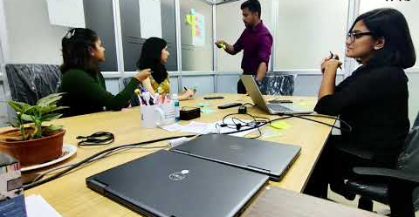
Brainstorming
Go through the video and come up with variety of ideas to resolve or address your Project.
Intersection Cafe: Collaborate | Coordinate | Co-create

Slide 81
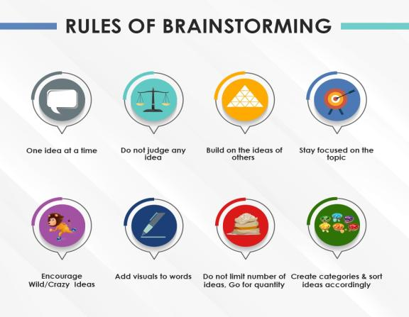
Rules of Brainstorming
While ideating your ideas make sure you keep in mind the rules.
Intersection Cafe: Collaborate | Coordinate | Co-create

Slide 82
Idea Generation for your Project
List your initial set of IDEAS-
1. | 2.
3. | 4.
5. | 6.
7. | 8.
9. | 10.
11. | 12.
Note: You can add as many ideas as possible
Intersection Cafe: Collaborate | Coordinate | Co-create

Slide 83
Idea Generation for your Project
Sort & categorize
Category 1 | Category 2
Note: You can add as many ideas as possible
Intersection Cafe: Collaborate | Coordinate | Co-create

Slide 84
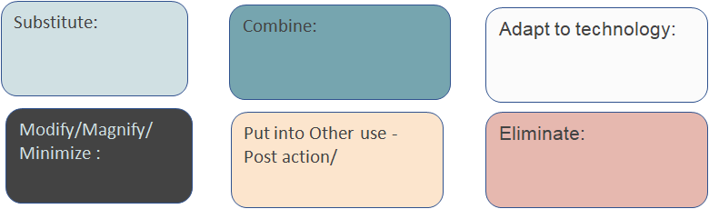
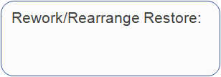
SCAMPER Technique –
Generate Your Ideas-using keywords or operators
You can add more slides as you get more ideas
Intersection Cafe: Collaborate | Coordinate | Co-create

Slide 85
Idea Generation for your Project
List your additional ideas after SCAMPER
1. | 2.
3. | 4.
5. | 6.
7. | 8.
9. | 10.
11. | 12.
Note: You can add as many ideas as possible
Intersection Cafe: Collaborate | Coordinate | Co-create

Slide 86
Idea Generation for your Project
List your ideas after Six Thinking Hats Exercise
1. | 2.
3. | 4.
5. | 6.
7. | 8.
9. | 10.
11. | 12.
Note: You can add as many ideas as possible
Intersection Cafe: Collaborate | Coordinate | Co-create

Slide 87
3.0 – An Exercise- How to Evaluate?
Imagine that your family has moved to Hubli and you are searching for a suitable school for your younger sibling.
School options are given below
•V S Pillya
•KLE
•Chetan
•Kendriya Vidyalaya
Factors you consider before selecting the best school:
•Fees
•Education quality
•Distance
• Infrastructure
When you spoke to some friends and other parents the information you got was:
•V S Pillya (VSP)- was quite far from the centre of the city, though had bus facility, had good infrastructure and excellent education quality.
•KLE- was in the centre of the city, had no bus facility, had excellent infrastructure and good education quality
•Chetan (C ) was located at the edge of city, not very far, had not, had adequate infrastructure and education quality was reasonable
•Kendriya Vidyalaya (KV) was in the opposite side of the city when compared to Chetan ,had bus facility, was well managed with adequate infrastructure and average education quality
Among the above, the fees were highest for V S Pillya with Kendriya Vidyalaya being the lowest and KLE Tech and Chetan were the same between VSP & KV.
Intersection Cafe: Collaborate | Coordinate | Co-create

Slide 88
3.0 – An Exercise
Criteria | Ranking (1 to 5)
 | A | Score | C=A*B | Score | E=A*D | Score | G=A*F | Score | I=A*H
 |  | B |  | D |  | F |  | H
Total
1st Choice
Remember the steps
Rank the factors 1 to 5 scale, 5 being the best
Assign the suitability score 3 being most suitable and 1 being least suitable
Calculate the weightage for each school
Add the columns to get the best score
Intersection Cafe: Collaborate | Coordinate | Co-create

Slide 89
3.0 – Your Project (Approach 1)
Criteria | Ranking (1 to 5) | Idea 1 |  | Idea 2 |  | Idea 3 |  | Idea 4
 | A | Score | C=A*B | Score | E=A*D | Score | G=A*F | Score | I=A*H
 |  | B |  | D |  | F |  | H
Total
1st Choice
Intersection Cafe: Collaborate | Coordinate | Co-create

Slide 90
3.0 – Your Project (Approach 2)
Criteria |  | Factors for Evaluation –for
Ideas | Ease of adoption | Resources | Cost of Service | Service required | Time | Social Impact
key for rating | easy to adopt not so easy to adopt | 1.less is required 2. more is required | 1-affordable 2. needs funds | 1. Very less 2. Quite Frequent | 1-less is required 2. more is required | 1- Effective user benefits 2. Less user benefits
Intersection Cafe: Collaborate | Coordinate | Co-create

Slide 91
3.0 – Your Project (Approach 3)
Degree of Impact or Benefit |  | 2.Low Effort – High Impact Implement Now | 4.High Effort – High Impact After benefit from 2 is realized and this can be the next level
 | High | Minimum Resources Less time Good benefit Fast user adoption Less service | More Resources More time Greater benefits Fast user adoption Frequent Service
 | Low | Minimum Resources Less time Not much benefit Less user adoption Less Service | More Resources More time Not much benefit Less user adoption Frequent Service
 |  | 1.Low Effort- Low Impact Keep for later | 3.High Effort – Low Impact Discard
 | Ease of Effort or Feasibility
Intersection Cafe: Collaborate | Coordinate | Co-create

Slide 92
3.0 – Your Project (Approach 3)
 | List your ideas as per the evaluation scores in the previous slide
Degree of Impact or Benefit | High | 2.Low Effort – High Impact Implement Now | 4.High Effort – High Impact After benefit from 2 is realized and this can be the next level
 | Low
 |  | 1.Low Effort- Low Impact Keep for later | 3.High Effort – Low Impact Discard
 | Ease of Effort or Feasibility
Intersection Cafe: Collaborate | Coordinate | Co-create

Slide 93
Idea Selection to be used in 4th module- Prototype
FINAL IDEA SET
Note: You can finalize one or two best ideas for Prototyping
Intersection Cafe: Collaborate | Coordinate | Co-create

Slide 94
Great Work Team!

Slide 95
Prototype
The Intersection Café
Collaborate | Coordinate | Co-create

Slide 96

The Prototype Module
After Ideate the next stage in Design Thinking is Prototype, where you and your team attempt to resolve a Project and develop a best possible solutions by understanding and utilizing various tools and techniques to bring the best outcomes for your specific Project.
Note : Once you start working on Prototype phase for your project and observe that collected data is not sufficient to work with, then please go back to respective stakeholders or community and collect the necessary information. Remember Design Thinking is an iterative process.
Intersection Cafe: Collaborate | Coordinate | Co-create

Slide 97
1.1-Observe, Design, and Create
Frame 1
Please add your Freeze frame photos for the above topics and make a create a slideshow.
Intersection Cafe: Collaborate | Coordinate | Co-create

Slide 98
1.1-Observe, Design, and Create
Frame 2
Please add your Freeze frame photos for the above topics and make a create a slideshow.
Intersection Cafe: Collaborate | Coordinate | Co-create

Slide 99
1.1-Observe, Design, and Create
Frame 3
Please add your Freeze frame photos for the above topics and make a create a slideshow.
Intersection Cafe: Collaborate | Coordinate | Co-create

Slide 100
1.1-Observe, Design, and Create
Frame 4
Please add your Freeze frame photos for the above topics and make a create a slideshow.
Intersection Cafe: Collaborate | Coordinate | Co-create

Slide 101
1.1-Observe, Design, and Create
Frame 5
Please add your Freeze frame photos for the above topics and make a create a slideshow.
Intersection Cafe: Collaborate | Coordinate | Co-create

Slide 102
1.1-Observe, Design, and Create
Frame 6
Please add your Freeze frame photos for the above topics and make a create a slideshow.
Intersection Cafe: Collaborate | Coordinate | Co-create

Slide 103
1.1-Observe, Design, and Create
Frame 7
Please add your Freeze frame photos for the above topics and make a create a slideshow.
Note: If needed add additional frames
Intersection Cafe: Collaborate | Coordinate | Co-create

Slide 104
The guidelines for creating Action Plans are :
The guidelines for creating Action Plans are :
            What is the plan and how will it be done?
            Who will do, individual &/or team ?
            When will it be done?
            Get feedback on the results
            Corrective steps if any
Sl no | What & How | Who | When | Feedback | Corrective Steps
1
2
3
4
Intersection Cafe: Collaborate | Coordinate | Co-create

Slide 105
Action Plans Format
Sl no | What & How | Who | When | Feedback | Corrective Steps
1
2
3
4
Intersection Cafe: Collaborate | Coordinate | Co-create

Slide 106
3.1-Prototype Building
Ensure a user centric approach as you are finalising the specifications by correlating the designs in a matrix and evaluating with a “what if” analysis
Solutions | User Categories
The solution detail-Please enter
Intersection Cafe: Collaborate | Coordinate | Co-create

Slide 107
3.1-Prototype Building
Ensure a user centric approach as you are finalising the specifications by correlating the designs in a matrix and evaluating with a “what if” analysis, ie what if resources are not available, what if everyone does not agree ..and so on
The solution detail-Please enter
“What if” questions?
“How might we “ solve if the solution does not work effectively.
Intersection Cafe: Collaborate | Coordinate | Co-create

Slide 108
Great Work Team!

Slide 109
Test
The Intersection Café
Collaborate | Coordinate | Co-create

Slide 110

The Test Module
Testing is the fifth stage in the iterative process of Design Thinking, involves generating user feedback as related to the prototypes you have developed, as well as gaining a deeper understanding of your users and a final component of product development.
Note : Once you start working on Test phase for your project and observe that collected data is not sufficient to work with, then please go back to respective stakeholders or community and collect the necessary information. Remember Design Thinking is an iterative process.
Intersection Cafe: Collaborate | Coordinate | Co-create

Slide 111
1.2-Selection of Sample Size and Target Group
Understand the process in the LMS and apply the same method for your Project .
Project | Target Group | Sample Size | Test Run
Intersection Cafe: Collaborate | Coordinate | Co-create

Slide 112
Lesson 2.1 : The Plan Do Check Standardize/Act Cycle- Structured Flow (Step 1)
Action Plan From Prototype
Why : The purpose of this action plan to ensure safe and reliable bus pick up and drop students to go to school
Sl no | What & How (Plan) | Who | When | Feedback | Corrective steps
1
2
3
Note: Please add additional rows if needed
Intersection Cafe: Collaborate | Coordinate | Co-create

Slide 113
Lesson 2.2 : The Plan Do Check Standardize/Act Cycle- Structured Flow (Step 2)-1 example
The Checklist - Format 1 Week Trials |  |  | Checked by Students & Parents
Day | Write the 1st activity |  | Write the 2nd activity |  | Write the 3rd activity
 | YES | NO | YES | NO | YES | NO
Monday
Tuesday
Wednesday
Thursday
Friday
Any Other Points:
Intersection Cafe: Collaborate | Coordinate | Co-create

Slide 114
Lesson 2.2 : The Plan Do Check Standardize/Act Cycle- Structured Flow (Step 2)-2nd example
The Checklist - Format 1 Week Trials |  |  | Checked by Stakeholders
Day | Write the 1st activity |  | Write the 2nd activity |  | Write the 3rd activity
 | YES | NO | YES | NO | YES | NO
Monday
Tuesday
Wednesday
Thursday
Friday
Any Other Points:
Intersection Cafe: Collaborate | Coordinate | Co-create

Slide 115
Lesson 2.3 : The Plan Do Check Standardize/Act Cycle- Structured Flow (Step 3)
Test - Checklist
Sl no | The Plan | Action | Check Points | Feedback | Corrective steps | Standardized
1
2
3
Note: Please add additional rows if needed
Intersection Cafe: Collaborate | Coordinate | Co-create

Slide 116
Lesson 2.4 : User Experience & Iterative Process
Write a brief description
Your Solution/s
User Feedback : ❑. ❑. ❑. ❑.
Name -
Intersection Cafe: Collaborate | Coordinate | Co-create

Slide 117
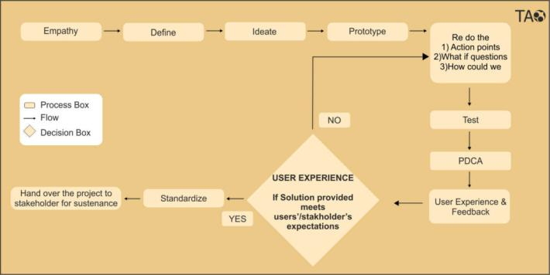
Lesson 2.4 : User Experience & Iterative Process
If the user group is not fully satisfied with the solution then consider the feedback from the user and re- Iterate the process from prototype or define stage and ensure full satisfaction and desired outcome
Intersection Cafe: Collaborate | Coordinate | Co-create

Slide 118
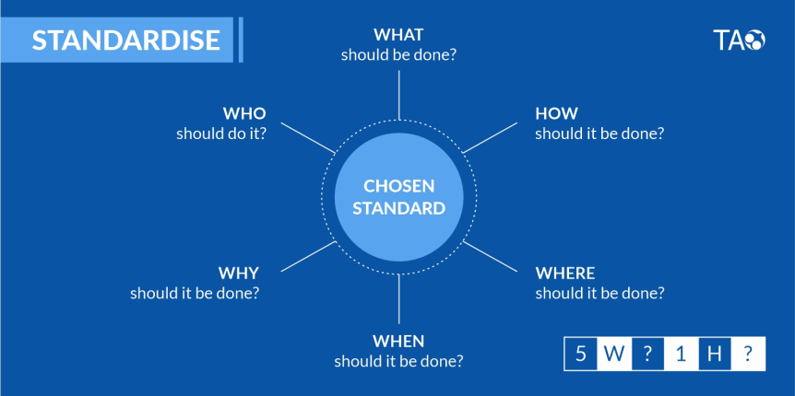
Lesson 3 : The Standardize Cycle
Intersection Cafe: Collaborate | Coordinate | Co-create

Slide 119
Lesson 3 : The Standardize Cycle
Use the Standardize Cycle and the standardise the solution accordingly and hand it over to stakeholders/ users after thorough explanation. Create a Standard Operating Procedure or SOP
The Purpose: (Why) Objective to be achieved
The Steps | add content with full details | special remarks or care if any
What should be done ?
How should it be done?
Where should it be done?
When should it be done ?
Who (all) should it ?
Intersection Cafe: Collaborate | Coordinate | Co-create

Slide 120
Great Work Team!

